Slide 1
Bell Ringer
Citizenship & Rights Test: Next Class!
Reflect on the different lessons that we’ve had about citizenship and rights.
Click on the “Bell Ringer” tab to take a survey about your thoughts on this unit.

Slide 2
Assignment: Review Sheet (in groups)
Find your group pairing and go to that channel.
Join the video call that will be started in that channel. Make sure to keep your cameras and microphones on!
Go to the Files tab of that channel. You will see the Test 1 Study Guide document.
Work together to complete the review sheet. You may divide up the work, but you must work together.
You can find the various readings and PowerPoints in the Files section of the general channel.

Slide 3
Period 5 - Groups
GROUP 1:
BASTIDAS, Guillermo
BORDES, Samuel
CHINCHILLA, Qadira
DONALDSON, Princess
EHABAHE, Fortune
HERRERA, Gabriel
VILLANUEVA, Ariana
GROUP 2:
ALBEDYLL, Andrew
ALVAREZ-PAGAN, Nehemyah
ESPINOSA, Alexander
FERNANDEZ, Saige
GARCIA, Angel
GONZALEZ, Yulian
YANES, Nayeli
GROUP 3:
JONES, Caleb
JUAREZ, Sheyla
KALOGERAS, Charley
MARCANO, David
MARIN, Chantell
MORENO, Johnathan
YANTANI, Luca
GROUP 4:
QUINTANA, Mia
RAMIREZ, Jordan
RIVERA, Jaycelynn
ROSADO RIVERA, Loriana
RUBY, Daniel
TINEO SANTO, Jarol
VELASQUEZ, Genesis

Slide 4
Period 7 - Groups
GROUP 1:
AGUIAR, Lucas
CARBONELL, Abigail
DIAZ, Kelin
FLINT, Terry
MONTERO, Giancarlo
LOPEZ, Mei
GROUP 2:
ARRIAGA, Keren
ARTEAGA-PELAEZ, Daniela
BENNETT, Thomas
BRYANT, Skyler
HUBMAN, Cole
GROUP 3:
GARCIA, Jonathan
GARCIA, Nicholas
GOIZUETA, Melanie
LEE, Ethan
ORTA, Andrew
SALGADO, Ronald
GROUP 4:
CLARK, Derric
DUSSAN, Santiago
GOMEZ, Armando
LEZCANO, Elizabeth
VIEYRA, Ashley
YANES, Daraimis

Slide 5
Period 8 - Groups
GROUP 1:
BANDA, Saul
DAVIS, Makayla
JACKSON, Melvin
FEUILLEBOIS, Emily
PEREZ, Christian
GROUP 2:
ALEMAN, Efren
BLANCO VALLECILLO, Diana
DOMINGUEZ, Emily
DUARTE, Sebastian
JIMENEZ, Juan
PEREZ, Britney
GROUP 3:
MARTINEZ, Bryce
PERERA, Michelle
PEREZ, Yarely
RODRIGUEZ, Geovanni
SURUJBALLI, Ethan
VINAS, Juan
GROUP 4:
ACOSTA, Diana
MOAHAMED, Jocelyn
RALLS, Kailee
RAUDA-VIDAL, Carlos
VAZQUEZ, Katelyn

Slide 6
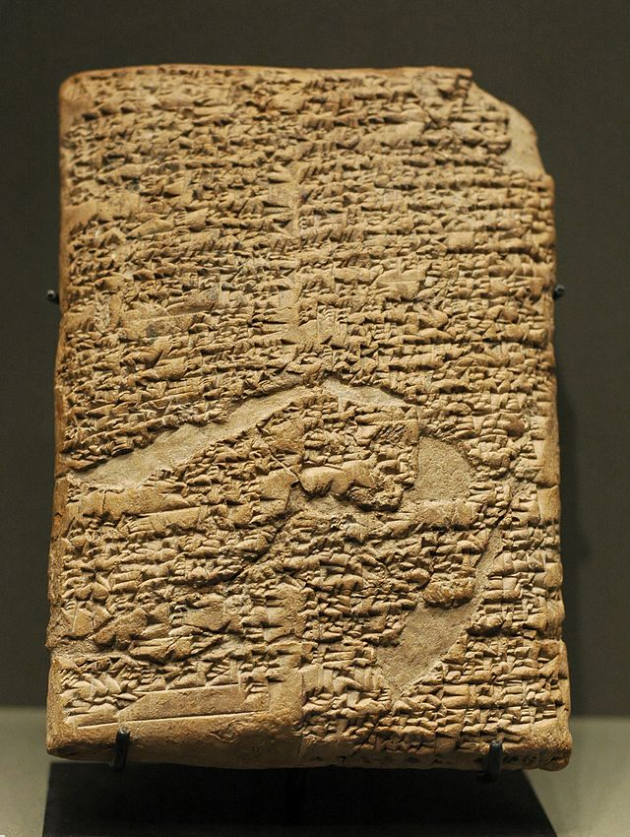
What is a law?
A law is a rule for
society.

Slide 7

RULE OF LAW
RULE OF LAW means that:
No one is above the law
Everyone must follow the law
The law applies equally to everyone
We are a country of laws, not of men
Laws and procedures are transparent and fair

Slide 8
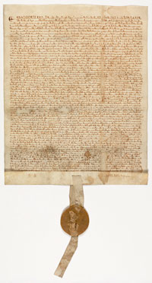
Where did the Rule of Law originate?
The Rule of Law was first found in Magna Carta, 1215
This document, signed by King John, stated that even the king had to follow the laws.

Slide 9
Principles of the Rule of Law
The Rule of Law has a huge impact on our government officials and institutions, from how they are held accountable (responsible) to how decisions are made to how laws are enforced!
Four Principles of the Rule of Law
Principle 1
Principle 2
Principle 3
Principle 4
Accountability to the law
Decisions based on the law
Fair procedures
Consistent application

Slide 10
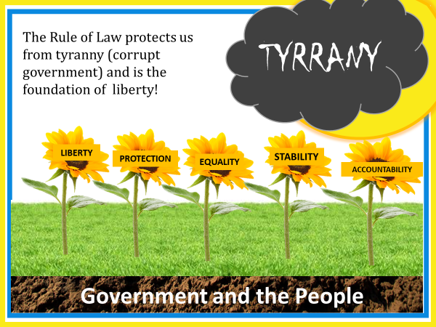
WHERE DID THE RULE OF LAW ORIGINATE?
The Rule of Law was first found in Magna Carta, 1215
This document, signed by King John, stated that even the king had to follow the laws.

Slide 11
Citizenship
Citizen
A legally recognized member of a country.
Values
Ideas that people hold dear and try to live by.
Citizens have different roles and jobs to help preserve freedom and ensure justice & equality for all Americans.

Slide 12
Citizenship
Equality
Everyone has the same right to enjoy the benefits granted to all.
Liberty
Freedoms guaranteed to all.
Justice
Your rights and freedoms cannot be taken away.
Citizens have different roles and jobs to help preserve freedom and ensure justice & equality for all Americans.

Slide 13
What does it mean to be a citizen?
Citizen: A legally recognized member of a country.
What does being a citizen mean to you?

Slide 14
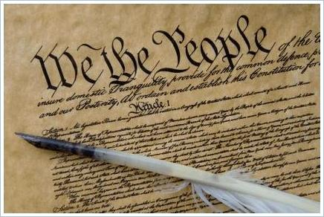
What does the Constitution of the United States Say about citizenship?
The Constitution is like a rule book for government: it outlines the structure and function of our government and names some of the rights of the people.

Slide 15
The Fourteenth Amendment
Defines citizens as “all persons born or naturalized in the United States”

Slide 16
Natural Born Citizens
Who is a natural born citizen of the United States?

Slide 17

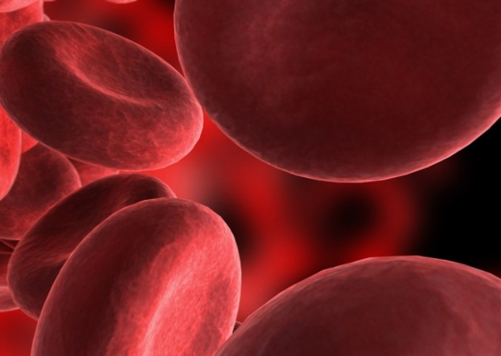
Natural Born Citizenship is based on two “laws”:
“Law of Blood”
Children born to a parent or parents who are United States citizens.
“Law of Soil”
Children born in the United States or Territories/Possessions
S
B

Slide 18


To Sum It Up…
Law of Soil – WHERE you are born (must be within the United States or territory/possession)
Law of Blood – WHO you are born to
S
B

Slide 19
NATURALIZATION
How someone can become a citizen of the United States.

Slide 20
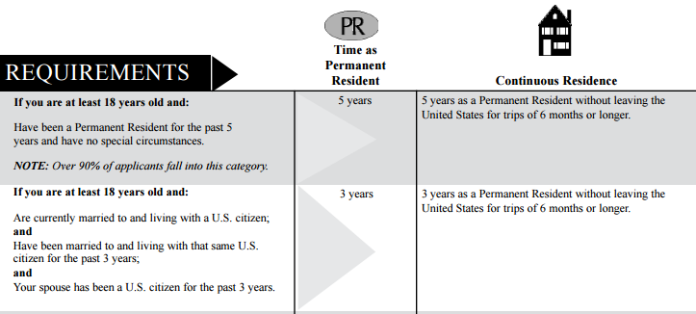
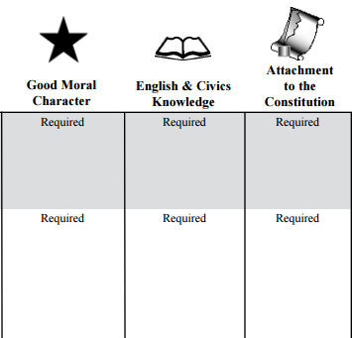
To Become a Naturalized Citizen…
There are special considerations for those who serve in the military or served during times of war/conflict.
Notes:
Go over the chart provided to explain the naturalization process. Permanent residents also must establish “continuous residence” in the U.S., meaning they cannot leave the country for trips longer than 6 months.

Slide 21
Defining Immigrants, Residents, and Aliens
Immigrant
Alien
A person who comes to live permanently in a foreign country.
A resident is someone who has been legally allowed to live in the United States, but is not a citizen
Any person not a citizen or national of the United States.
Resident

Slide 22
Bell Ringer
Citizenship & Rights Test: Next Class!
Reflect on the different lessons that we’ve had about citizenship and rights.
Click on the “Bell Ringer” tab to take a survey about your thoughts on this unit.

Slide 23
How do citizens participate?
Obligations and Responsibilities of Citizens

Slide 24
What does that mean?
Obligation/Duty
Responsibility
An obligation or duty is something you must do because of legal requirement
An example? Obey the law!
A responsibility is something that you are expected to do
An example? Vote!

Slide 25
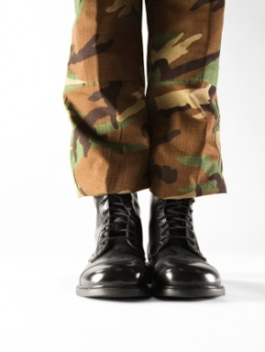
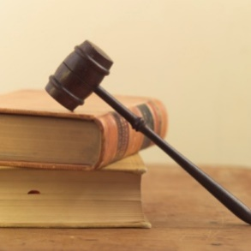
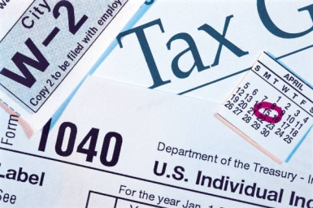
Examples of Obligations/Duties
Obey the law
Attend school
Pay taxes
Defend the nation
Register for selective service: draft; required military service during times of need
Serve on juries
Notes:
Ask students who is required to follow the law. Answer: EVERYONE. There is a concept called “rule of law” that means everyone must follow the law and no one is above the law.
Go on to explain that because of laws, we are required to pay taxes, defend the nation in times of need, and serve on juries.

Slide 26

Examples of a civic responsibility:
Voting
Being informed
Taking part in government
Helping your community
Respecting and protecting the rights of others
Notes:
Tell students these are just some of the responsibilities they have in their communities. Other responsibilities can include: volunteering, staying informed, joining civic organizations, and more.

Slide 27
What do you think?
What would be the consequences or outcome on society if citizens did not fulfill their responsibilities?
Notes:
Make sure students consider the importance of civic participation. What if people did not vote? What if people did not volunteer? What if we did not petition the government? What if people didn’t run for public office?
We would experience many of the same people running the government with no new ideas and lack of representation of the people.

Slide 28
Fulfilling Our Obligations and Responsibilities
What to we achieve by fulfilling our obligations and responsibilities in our communities?
COMMON GOOD!
The common good is supporting the good of the community as a whole.
Notes:
Explain the common good serve to support the community as a whole by doing the most good for the most amount of people. Common good is promoted by participating in the civic life of our community and fulfilling our obligations.

Slide 29
Role of the Constitution
Outline the structure and function of government
Protect the rights of the people

Slide 30
The Bill of Rights
Rights: guarantees or protections
Bill of Rights: The first 10 amendments to the US Constitution
Amendments are changes or additions to a document

Slide 31
HOW DID WE GET THE BILL OF RIGHTS?
Federalists vs. Anti-Federalists

Slide 32
Difference of Opinion
Federalists
Anti-Federalists
Were worried that the Constitution would bring tyranny
People should be protected from the power of government by having clearly outlined rights in a “Bill of Rights” in the Constitution
Wanted the Constitution to be approved
Believed the Constitution in its original form would protect the rights of the people

Slide 33
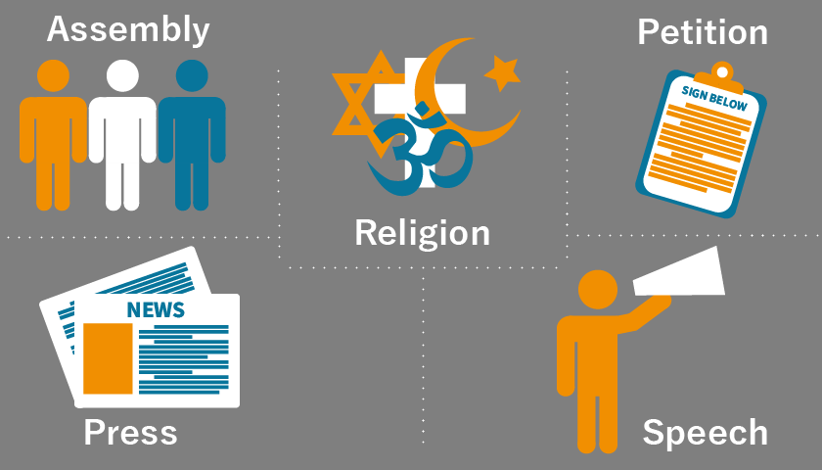
1st Amendment

Slide 34
Bill of Rights
Amendment | Rights/Guarantees
1st | Freedom of expression
2nd-3rd | Protection
4th-8th | Rights of the accused
9th-10th | Rights of citizens and the states

Slide 35
2nd Amendment: Right to Bear Arms
A well regulated Militia, being necessary to the security of a free State, the right of the people to keep and bear Arms, shall not be infringed.
Notes:
Ask the students who is responsible for interpreting the meaning of the Constitution. The judicial branch. The second amednment has been the subject of many debates – did the Founders think just the militia should have arms? Did they think it was the right of all people?
The court has determined in D.C. v. Heller. From the opinion: The Second Amendment protects an individual right to possess a firearm unconnected with service in a militia, and to use that arm for traditionally lawful purposes, such as self-defense within the home. Like most rights, the Second Amendment right is not unlimited. The Court’s opinion should not be taken to cast doubt on longstanding prohibitions on the possession of firearms by felons and the mentally ill, or laws forbidding the carrying of firearms in sensitive places such as schools and government buildings, or laws imposing conditions and qualifications on the commercial sale of arms.

Slide 36
4th Amendment: Protection from Unreasonable Search and Seizure
The right of the people to be secure…against unreasonable searches and seizures, shall not be violated, and no Warrants shall issue, but upon probable cause…

Slide 37
5th Amendment: Protection from Double Jeopardy
No person shall…be subject for the same offence to be twice put in jeopardy of life or limb…

Slide 38
5th Amendment: Protection from self-incrimination
No person shall…be compelled in any criminal case to be a witness against himself…

Slide 39
5th Amendment: Due Process
No person shall…be deprived of life, liberty, or property, without due process of law…

Slide 40
5th Amendment: Eminent Domain
…Nor shall private property be taken for public use, without just compensation.

Slide 41
6th Amendment: Right to Legal Counsel
In all criminal prosecutions the accused shall…have the Assistance of Counsel for his defence.

Slide 42
6th Amendment: Right to Trial by Jury
In all criminal prosecutions, the accused shall enjoy the right to a speedy and public trial, by an impartial jury of the State and district wherein the crime shall have been committed…
In suits at common law, where the value in controversy shall exceed twenty dollars, the right of trial by jury shall be preserved…

Slide 43
8th Amendment: Protection from Cruel and Unusual Punishment
Excessive bail shall not be required, nor excessive fines imposed, nor cruel and unusual punishments inflicted.

Slide 44
Test your knowledge…
Read the situation on the slide.
If you think it is a responsibility, you will go to the right side of the room.
If you think it is an obligation, go to the left side of the room.
Obligation
Responsibility

Slide 45
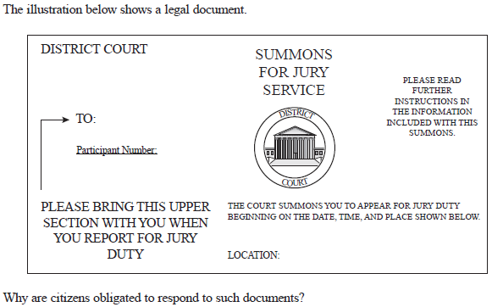
Scenario 1
Mark receives a summons for jury duty. He serves on a jury for two weeks listening to testimony about a robbery that took place and determining the verdict for the case along with his fellow jurors.
Is Mark’s service on a jury a responsibility or an obligation?

Slide 46
Is Mark’s service on a jury a responsibility or an obligation?
Obligation!
Florida law states that any person who is summoned to attend as a juror in any court and who fails to attend without any sufficient excuse shall pay a fine not to exceed $100.
Obligation
Responsibility
Notes:
Jury duty serves a critical function in our society by protecting the constitutional right to trial by jury. Juries are necessary for protecting the rights of those accused of crimes and providing an unbiased verdict in criminal and civil cases.
Florida law (Section 40.23 Florida Statues) states that any person who is duly summoned to attend as a juror in any court and who fails to attend without any sufficient excuse shall pay a fine not to exceed $100, which fine shall be imposed by the court to which the juror was summoned, and, in addition, such failure may be considered a contempt of court.

Slide 47
Scenario 2
On his 18th birthday, Marshall went online and registered for the selective service. This means that in a crisis requiring a draft, men would be called in sequence determined by random lottery number and year of birth.
Is Marshall’s registering the selective service a responsibility or an obligation?

Slide 48
Is Marshall’s registering for the selective service a responsibility or an obligation?
Obligation!
The Military Selective Service Act states that “it is the duty of every male citizen of the United States, and every other male person residing in the United States, who, on the day or days fixed for the first or any subsequent registration, is between the ages of eighteen and twenty-six, to present himself for and submit to registration.”
Obligation
Responsibility
Notes:
From the Military Selective Service Act: Except as otherwise provided in this title (sections 451 to 471a of this Appendix) it shall be the duty of every male citizen of the United States, and every other male person residing in the United States, who, on the day or days fixed for the first or any subsequent registration, is between the ages of eighteen and twenty-six, to present himself for and submit to registration at such time or times and place or places, and in such manner, as shall be determined by proclamation of the
President and by rules and regulations prescribed hereunder.

Slide 49
Scenario 3
Shauna did not like a policy that was recently passed by the state legislature. She decided to create a petition supported by members of her community and included a copy of the petition in a letter to her Representative.
Is petitioning the government a responsibility or an obligation?

Slide 50
Is petitioning the government a responsibility or an obligation?
Responsibility!
Why is petitioning the government an important civic responsibility?
Obligation
Responsibility

Slide 51
Scenario 4
Tax returns are due by midnight April 15th, so long as April 15th is not a weekend. John forgot to complete a tax return and thought it really was not a big deal – he could just wait until next year.
Is the filing of a federal tax return a responsibility or an obligation?

Slide 52
Is the filing of a federal tax return a responsibility or an obligation?
Obligation!
Federal law requires people to pay taxes.
Obligation
Responsibility
Notes:
From the IRS Internal Revenue Service (IRS) Internal Revenue Code:
TITLE 26 > Subtitle A > CHAPTER 1 > Subchapter A > PART I > § 1. Tax imposed
CLICK HERE to see all those who are subject to income tax in the United States.

Slide 53
Scenario 5
Sarah attends her city commission meetings each month so she can be informed about the issues impacting her community.
Is attending civic meetings a responsibility or an obligation?

Slide 54
Is attending civic meetings a responsibility or an obligation?
Responsibility!
Why is attending civic meetings an important part of civic participation?
Obligation
Responsibility
Notes:
By attending civic meetings, citizens can be informed about the events, laws, and issues that are present in their communities. Being an informed citizen is critical to a functioning society.

Slide 55

Scenario 6
Mariselle wakes up at 5:00am to go to the polls for the national elections so she can vote before she has to go to work.
Is voting in an election a responsibility or an obligation?

Slide 56
Is voting in an election a responsibility or an obligation?
Responsibility!
Why is voting an important form of civic participation?
Obligation
Responsibility

Slide 57
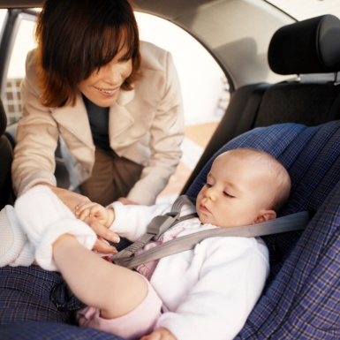
Scenario 7
Jackie is going to the grocery store and puts her 2 year old in a car seat in the back seat of the car.
Is using a car seat for a child a responsibility or an obligation?

Slide 58
Is using a car seat for a child a responsibility or an obligation?
Obligation!
Florida law requires…children through age 3 must be secured in a separate carrier (child safety seat) or in a vehicle manufacturer's integrated child safety seat…Infants must ride rear-facing until they are at least one year old and weigh 20 pounds
Obligation
Responsibility
Notes:
Stress this example as why it is important to follow laws. Laws are created to protect the public and ensure the safety of all.
316.613 Child restraint requirements.— Florida law requires…children through age 3 must be secured in a separate carrier (child safety seat) or in a vehicle manufacturer's integrated child safety seat…Infants must ride rear-facing until they are at least one year old and weigh 20 pounds or more. Rear-facing, the infant should be semi-upright at an angle or no more than 45 degrees. A forward-facing older child should ride sitting upright.
Violation of the child restraint law carries a fine of $60 and 3 points on the driving record.

Slide 59
Scenario 8
Juan doesn’t think his neighborhood association is running efficiently. He decides to run for president of the association in order to correct problems in his neighborhood.
Is running for an office in civic organization a responsibility or an obligation?

Slide 60
Is running for an office in civic organization a responsibility or an obligation?
Responsibility!
Why is running for office an important part of civic participation?
Obligation
Responsibility
Notes:
Running for office is one of the most direct forms of civic participation. Citizens can serve in different levels of government by representing the people from their communities and being their direct voice in government.

Slide 61
Civic Participation
Why is civic participation, both required and voluntary, so important?
In society?
In government?
In the political process?
Notes:
Society: Civic participation is critical for a thriving society. When we participate, we promote the common good by helping others, being engaged and educated, respecting the law, respecting others, defending our nation, supporting the government, and bringing concerns about government of community to the forefront.
Government: We are a government of the people, for the people, and by the people. Without our participation, government does not work properly. We are able to serve on juries, vote, and petition the government – all things that keep the government accountable and rights that we can exercise as citizens.
Political process: We live in a nation where we can participate in government. By voting, being informed, running for office, and petitioning the government, we are able to have our voice heard and make a difference in our communities.

